Slide 1
CS 447/647
Configuration Management

Slide 2
Overview
What is configuration management?
What programming paradigm does configuration management use?
What are the elements of configuration management?
What are some common configuration management tasks?

Slide 3
Configuration Management
Changes should be
Structured
Automated
Consistent
Difficult when dealing with heterogeneity
Debian, Ubuntu, CentOS
Windows: 10, Server 2012, Server 2019

Slide 4
Configuration Management (CM)
Automates the management of Operating Systems
Eliminate toil
Network-based
SSH - ansible
Client - Salt, Puppet, Chef
Text File Configurations
Ansible, Salt - Yet Another Markup Language (YAML)
Puppet - Ruby syntax
Chef - IDK
Developer Operations
Agile-like development process
Less hardware
More software engineering
Managing cloud resources
CLAMS - Culture, Lean, Automation, Measurement, Sharing
Notes:
Culture
24x7
Testing and monitoring
Little different between production and dev
Code reviews
Lean
Real-time interaction and communications
Automation
Perform a task twice, automate it.
Don’t automate what you don’t understand
Eliminates mundane tasks
Reduces human error
Scaling
Measurement
Helps you scale
Sharing
Silo-busting
Git
tools

Slide 5
Configuration Management in a Nutshell
Tradition Method
Shell scripts
Chaos - (Less time and micromanagey)
Procedural - violates a core Unix programming principle
Configuration Management Method
Capture state in code
Track changes in revision control (git)
Declarative - Describe the state
Task - create user, install package, copy files, modify configuration.

Slide 6
Dangers of Configuration Management
No standardization
Lexicons differ
Puppet - Agent node
Ansible - Host
Knowledge doesn’t transfer
Don’t mix CM with ad-hoc
Snowflake systems
Steep learning curves
Especially with large “code” bases
Test in production
Slows down development initially

Slide 7
Elements of Configuration Management
Operations and Parameters
Small-scale tasks and checks
Out-of-the-box tasks
Create or remove users
Copy files
Render templates
Add lines to config files
Restart services
Run shell commands
Applied repeatedly without causing problems
Detect state
Cross-platform

Slide 8
Elements of Configuration Management
Variables
Used in configuration templates
Different scopes
Types
Scalars
Arrays
Dictionaries
Facts
Discovers descriptive facts of client
IP
OS
Extensible

Slide 9
Elements of Configuration Management
Change Handlers
Operations to perform after a change
Restart web server after config change
Bindings
Associate tasks to specific Hosts
Bundles
Collection of operations
Setting up WWW server
Client Inventory and registration
Client daemon - Pull
Server - Push
Authentication

Slide 10
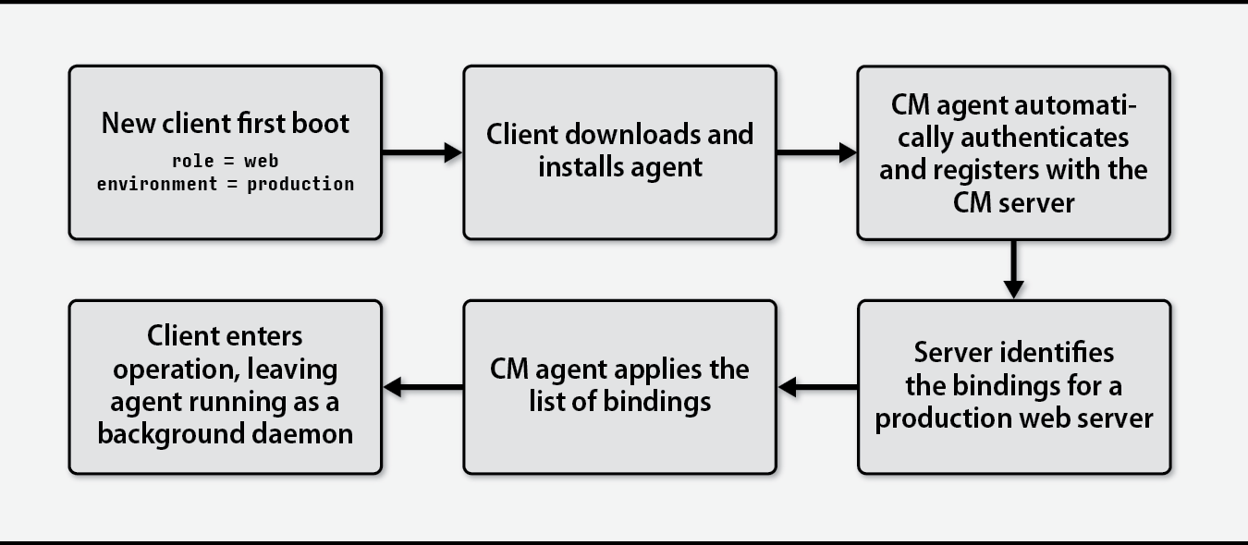
Setup

Slide 11
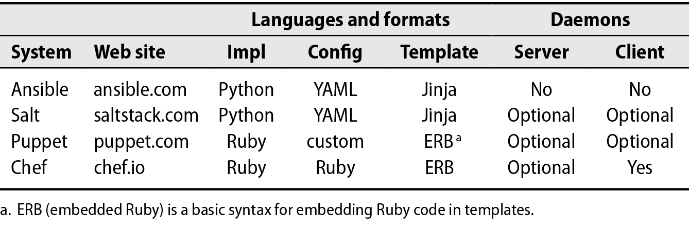
CM Systems
Microsoft Configuration Management (CM) - Windows GUI, Point and click.

Slide 12
Why YAML?
Simple Serialization Format
Encode an object as string
Not executable
Human readable
Whitespace delimited
Broad support for languages
Types
Integers, Floats, Timestamps, Collections, Strings, Dictionary (key:value)
Defines two functions
Dump (Present) and Load (Construct)
https://yaml.org/

Slide 13
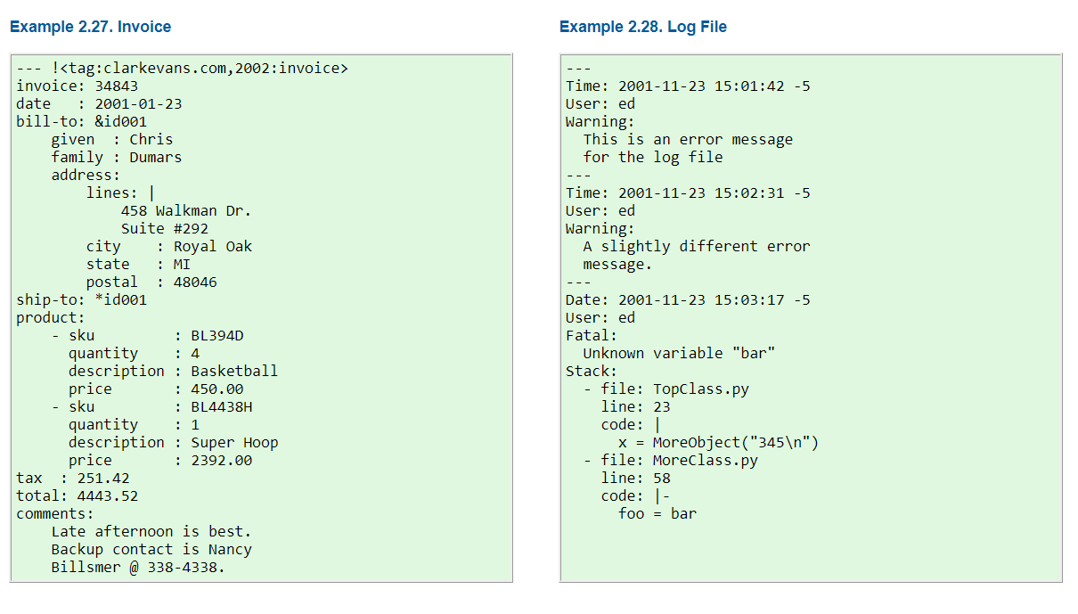

Slide 14
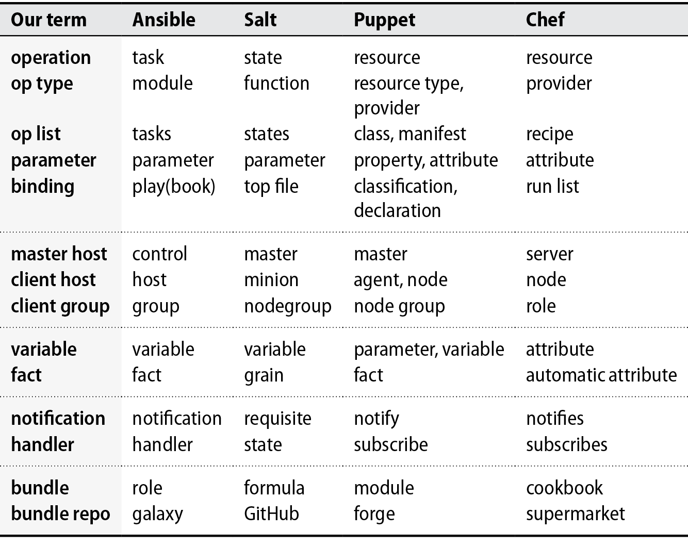

Slide 15
Introduction to Ansible
Configuring Ansible
Default configuration - /etc/ansible/ansible.cfg
User configuration - ~/.ansible.cfg
Example
Install sudo
Copy a sudoers file to server
Correct permissions
Add group named sudo
Add users to sudo group

Slide 16
pip and virtualenv
pip is a tool for installing and managing Python packages
ansible
psycopg2 - PostgreSQL database driver
Bundled with Python >=3.4
PyPi (Python Package Index) is a software repository
221,549 projects
virtualenv is a tool to isolate your Python environment
Separates libraries from the system

Slide 17
Virtual Environments
What if different applications require conflicting versions of a package?
Can’t install everything to /usr/lib/python3.6/site-packages
Virtual environments have their own installation directories
Work on different projects or use different applications within their own virtual environments

Slide 18
virtualenv
apt install virtualenv python3-virtualenv
virtualenv -p python3 path/env_name — create environment
source path/env_name/bin/activate — activate environment (Unix)
pip is installed into the environment

Slide 19
Setup
ssh $NETID@banyan.engr.unr.edu
mkdir confman && cd confman/ virtualenv -p python3 ansible_env source ansible_env/bin/activate pip install ansible

Slide 20
$HOME/.ansible.cfg
[defaults] private_key_file = /home/$NETID/.ssh/server remote_user = root

Slide 21
$HOME/hosts.yml
[vm] cs447-newellz2.ncr
[vm:vars] ansible_python_interpreter=/usr/bin/python3 host_key_checking = False ansible_ssh_common_args='-o StrictHostKeyChecking=no'

Slide 22
#Test
ansible -i hosts.yml -m ping vm
#Let’s do something more advanced now

Slide 23
Windows Ansible
OpenSSH Server or WinRM
Very new
alpha
Quite exciting, it replaces WinRM
WinRM was HTTP based
Install Document
https://docs.microsoft.com/en-us/windows-server/administration/openssh/openssh_install_firstuse

Slide 24
Steps
Enable and Install SSH
Add-WindowsCapability OpenSSH.Server~~~0.0.1.0
Add-WindowsCapability OpenSSH.Client~~~0.0.1.0
#Generate Keys
#Modify C:\ProgramData\ssh\administrator_authorized_keys

Slide 25
Windows Tasks
Installing Software
Installing Updates
Users and Groups
Registry Modification
“Shell” commands
cmd.exe or powershell
cmd.exe is the default
HKLM/Software/OpenSSH DefaultShell:string
Scheduled Tasks

Slide 26
Notes
https://galaxy.ansible.com/community/general

